Slide 1

Tyding what should never have been untied: Social Movements, Capitalism, and Class
University of Wisconsin-Madison
Álvaro Cabrera M.
Advisor: Dr. Gay Seidman.
Date: 08/17/2023

Slide 2
Classic Social Movement Agenda
The classic social movement research agenda (McAdam et al., 2004) has focused mainly on:
1) Resource Mobilization (McCarthy and Zald, 1977)
2) Political Opportunities (McAdam, 1999)
3) Collective Framing (Benford and Snow, 2000)

Slide 3
Classic social movement agenda
Currently, scholars have tried to link such perspective to a general collective action theory, resulting in contentious politics (McAdam et al., 2004).
Contentious politics, thus, has established itself as a “main” perspective on the studies of social movements and collective action.

Slide 4
The problem with classic social movement research agenda and contentious politics
The main problem of contentious politics is that it has positioned itself as a “catch-them-all” theory to analyze collective action.
Nonetheless, as many scholars have noted (Cini et al., 2017; Hetand and Goodwin, 2013), this framework has resulted incapable of explaining the new movements associated with austerity, precariousness, and inequality.

Slide 5
(Re)Turning to capitalism and Class
Many scholars have shown the importance of capitalism on recent social movements (della Porta, 2015; Cini et al., 2017; della Porta & Portos, 2020; Giugni & Grasso, 2016).
If the classical social movement agenda isn’t able to fully grasp the malaise raised by capitalism, then the focus should be on the structures in which capitalism develops.

Slide 6
Objective
General objective: Examine the relationship between capitalism and social movements.
Particular objective: Examine how class structure influences social movements and collective action.

Slide 7
Hyphoteses
Hypothesis 1 (H1): According to Chibber (2022), neoliberalism prompt resignation among the working class. Thus, capitalism should diminish the participation of the working class in collective action.
Hypothesis 2 (H2): Class identitiy is a key component in working class collective action (Eidlin & Kerrisey, 2022) which has mainly expressed in unions. Thus, participation in unions enhance working class colective action participation.

Slide 8
Methodology
This work uses a quantitative methodology.
In particular it uses a logistic multivariate regression.

Slide 9
Data
This article uses a quantitative methodology based on the Social Survey Programme 2014 - Citizenship II (ISSP) (N = 49.087).
After processing the dataset, the sample was reduced to 33.582 individuals nested in 34 countries

Slide 10
Dependant variable
The dependent variable is a dummy variable called “Collective Action Dummy”
It was composed by the summatory of four different variables that measure collective action:
- Signing a political petition
- Boycotting certain products
- Taking part in a demonstration
- Donating money

Slide 11
Independent variable
The dependant variable is “Social Class”.
This variable was based upon Erik Wright’s (1985, 1997) class criteria.
The means of production ownership
Skill level (measured by ISCO08)
Organizationl assets (informaly known as authority).

Slide 12
Independent variable
Self-employment | Number of employees | Skills | Supervises | Results
Yes | 10+ | - | Yes | Burgeoisie
Yes | 2 to 10 | - | Yes | Small Employers
Yes | 0 to 2 | - | Yes | Petty Burgeoisie
No | - | Yes | Yes | Expert Managers
No | - | Yes | No | Expert non-managers
No | - | Yes | Yes | Semi-credential managers
No | - | Yes | No | Semi-credential workers
No | - | No | Yes | Non-credential manager
No | - | No | No | Traditional proletarial

Slide 13
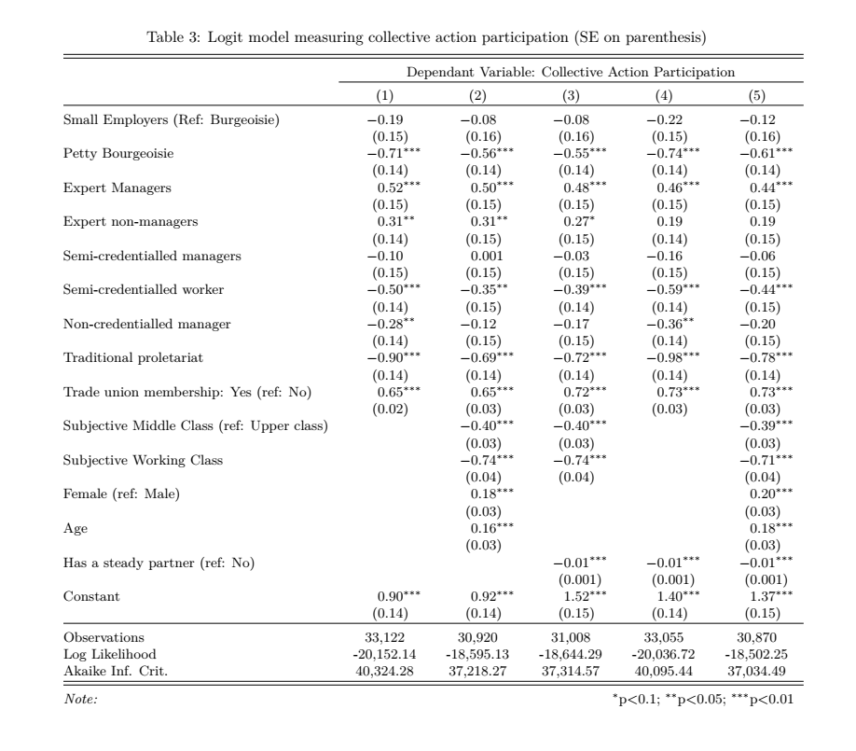
Preliminary results

Slide 14
